Slide 1

Open OnDemand
May 15, 2023

Slide 2
Outline
Open OnDemand on HPG
What is Open OnDemand?
Agenda
Questions
Open OnDemand Navigation & Demo

Slide 3

Agenda
May 29 – AMRFinder+ and Pha4ge’s hAMRonization pipeline
June 12 – Outbreak/Cluster Training
June 26 – GitHub and git clone
Future Trainings
ONT & FL’s Flisochar pipeline
Bactopia programs
StaPH-B Toolkit Programs/Pipelines
GISAID flagged SARS-CoV-2
Dryad pipeline
R Training series
…and more

Slide 4
What is Open OnDemand?
Open OnDemand is setup to provide a web interface to starting and attaching to HiPerGator jobs and it supports GUI programs, Job status, and other interactions with HiPerGator via seamless connections through web browsers.
Open OnDemand service is available at the following URL: https://ondemand.rc.ufl.edu
Note: IT Department may block from using Open OnDemand on your computer, so please make sure you contact IT people to solve this issue.

Slide 5
Open OnDemand on HPG
Connect to https://ood.rc.ufl.edu/
Launch a terminal
Launch many graphical applications like Rstudio, VScode, Matlab, etc.
Manage job submission
Upload, download, and edit files via your browser

Slide 6
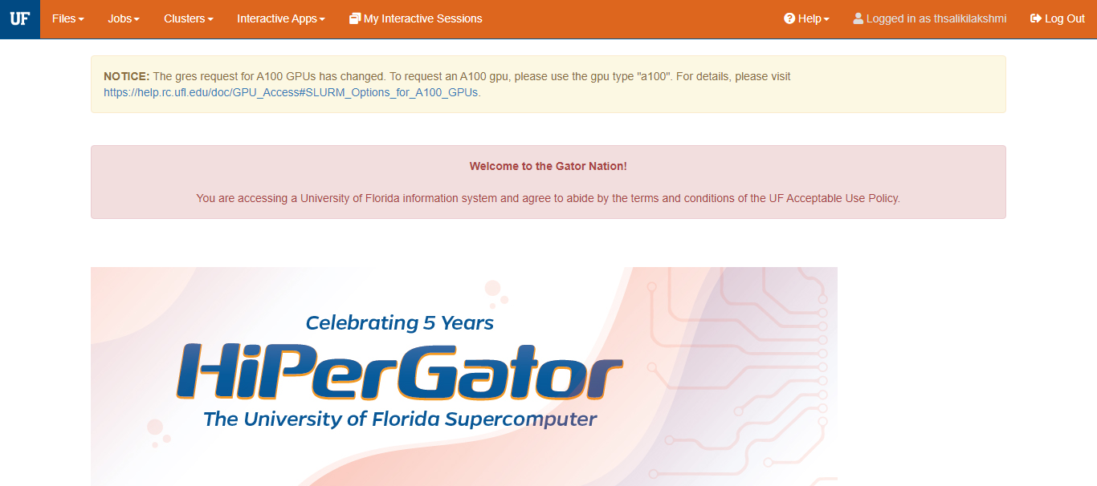
Open OnDemand Dashboard

Slide 7
Navigating menus on Dashboard
Files:
This menu will allow you to access your group’s storage areas including:
Home
Orange
Blue
Jobs:
This menu shows both the status and job composer links
Job status – shows the current status of your jobs like pending, running, and recently completed jobs
Job composer – allows the user to access OnDemand to run your existing SLURM scripts

Slide 8
Navigating Menus on Dashboard
Clusters
Opens a terminal shell in your browser that allows to access the HPG
Interactive apps
Drop-down menu with a list of the current interactive GUI applications available in OnDemand
If you don’t find the application you were looking for, feel free to select the “console” application and use the HPG ‘module load’ command to load and run your application

Slide 9
Navigating Menus on Dashboard
Some of the applications that are currently available are:
GUIs – console, Matlab, Rstudio, VScode, Spyder, etc.
HWGUI (Hardware GUI) Apps – Freeview, MRview, etc.
Servers – Jupyter Notebook
My Interactive sessions
Provides access to the list of the currently running interactive OnDemand jobs

Slide 10
Navigating Menus on Dashboard
Help
Provides access to some quick links for help on HPG and OnDemand
Logout
This helps you to logout of the OnDemand page

Slide 11
Starting an Interactive Application
Select the application from drop-down menu of “Interactive Applications” to start an interactive application
A form with the SLURM options will pop up on the screen for that application
Fill in the fields with the resources you would like to allocate for the application session

Slide 12
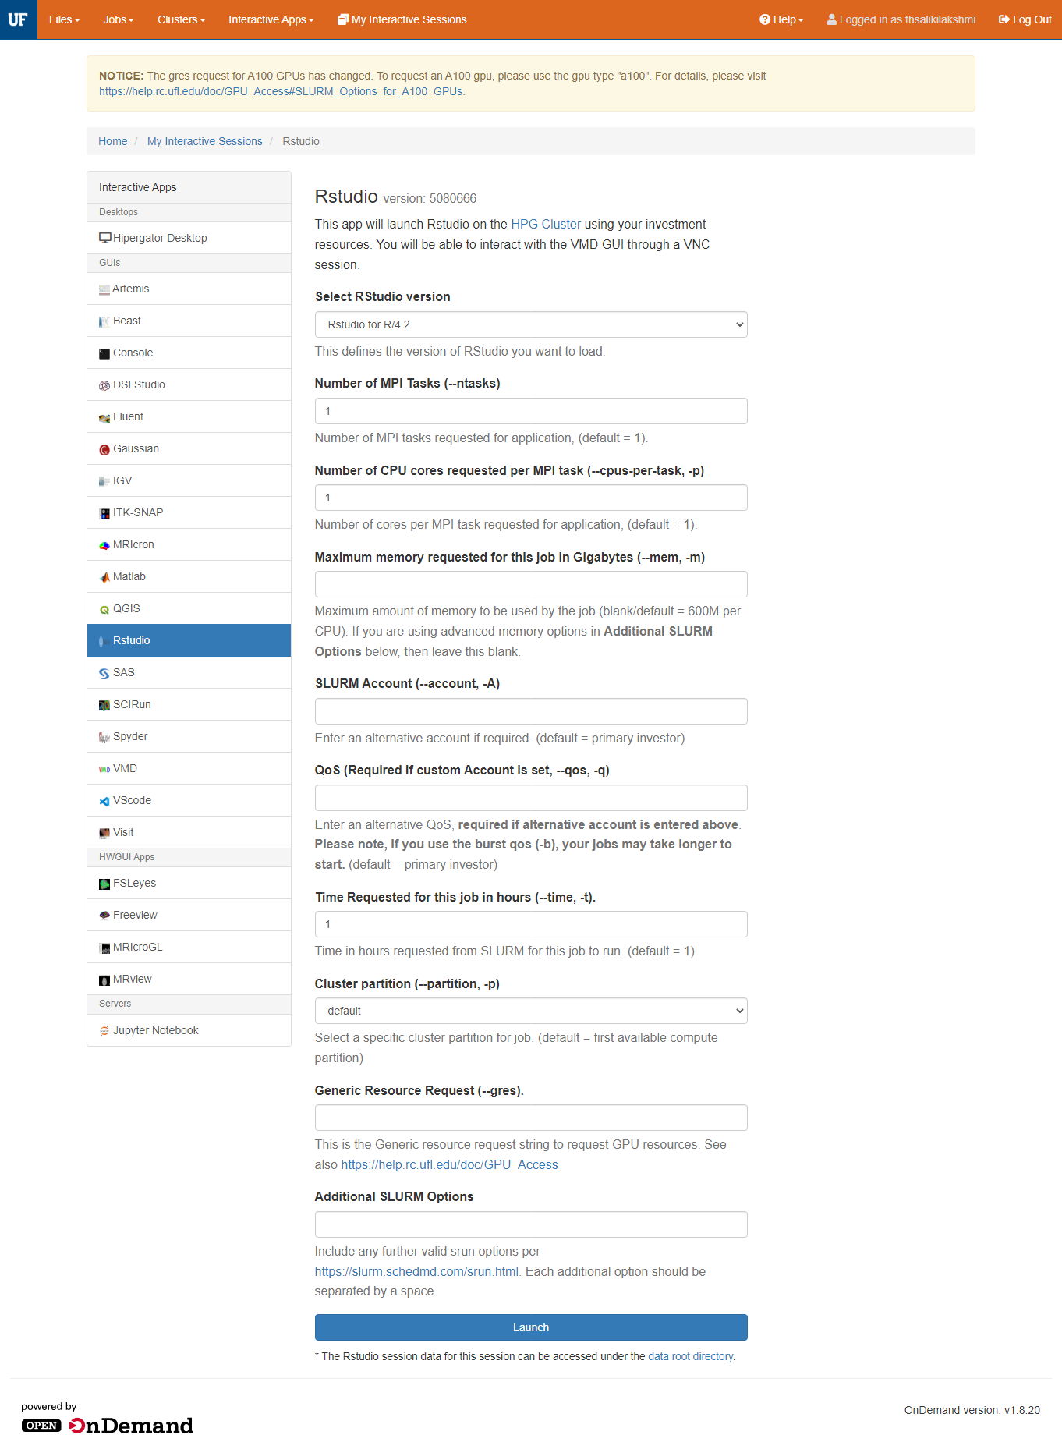
Interactive Application

Slide 13
General Form Fields
Version – select the version of the application you want to load
Number of MPI Tasks (--ntasks)
Number of CPU cores requested per MPI task (--cpus-per-task, -p)
Maximum memory requested for this job in Gigabytes (--mem, -m)
Note: If you are using advanced memory options in Additional SLURM Options below, then leave this blank.
Time Requested for this job in hours (--time, -t)

Slide 14
General Form Fields
SLURM Account (--account, -A): bphl-umbrella
QoS (Required if custom Account is set, --qos, -q): bphl-umbrella
Cluster partition (--partition, -p)
Generic Resource Request (--gres)
Additional SLURM Options
Select launch to submit your job request

Slide 15
Connecting to an Interactive application
Once the job has started, connect using the "My Interactive Applications" menu
Select this menu and you will see a connection box for each application you have running and pending
Once the job starts, a Launch (App Name) icon will appear
Select this link to open a new browser window connecting you to your application

Slide 16
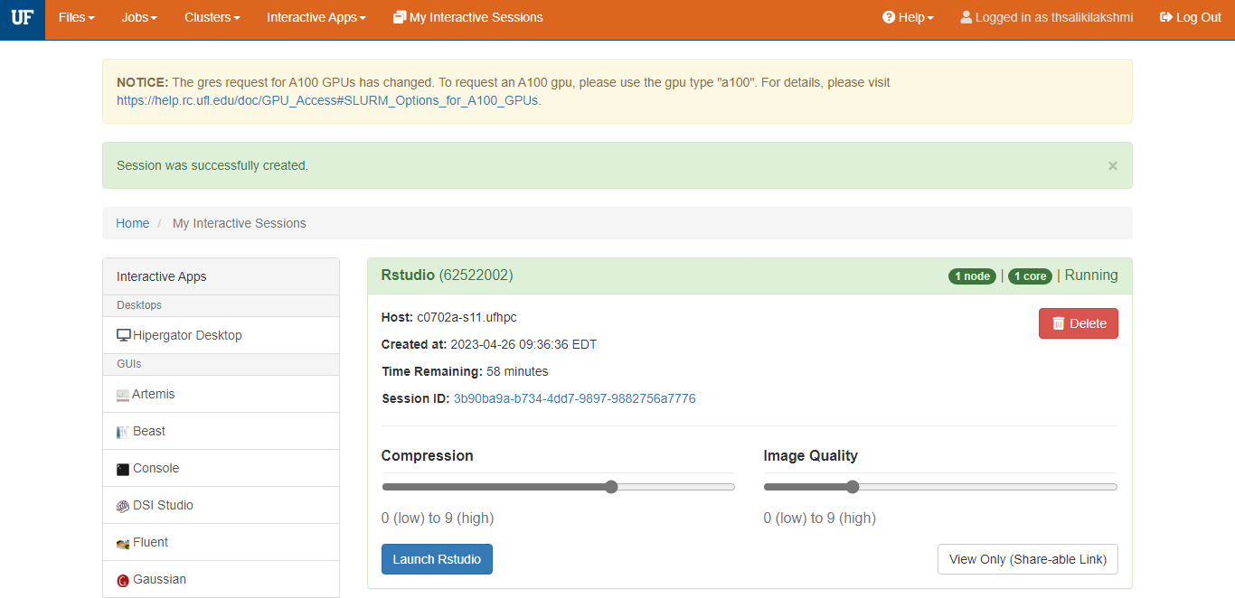
Job Connect Card

Slide 17
Job Connect Card
This section outlines several of the key features of the job connect card:
JobID: This is the SLURM JobID for this job
Delete: This will cancel a running job, (or delete the session if the job has already ended)
OOD Session ID: This is the unique identifier for the OOD session for this job, can be clicked to bring up the OOD log directory for troubleshooting

Slide 18
Job Connect Card
Image Quality: This setting controls the quality of the visual interface at the source, use a lower setting for slower internet connections
Compression: This setting adjusts the amount of CPU based compression used for the NoVNC connection, use higher settings for slower connections but note it will increase CPU usage on both the job and client
Launch Button: Click this button to connect to your running job in a web-browser session

Slide 19
VS Code Remote Development
Detailed information on VS Code Development can be accessed here VSCode Remote Development - UFRC (ufl.edu)
Visual Studio Code is a code editor redefined and optimized for building and debugging modern web and cloud applications
Running VSCode on HiPerGator through OOD is kind of slow and limiting in terms of extensions and updates

Slide 20
Time for Questions & Feedback
Questions?
Do you need help with anything?
Requests for separate trainings?
Feedback
What would you like to see?

Slide 21
Questions?
bphl-sebioinformatics@flhealth.gov
Lakshmi Thsaliki, MS
Bioinformatician
Lakshmi.Thsaliki@flhealth.gov
Molly Mitchell, PhD
Bioinformatician
Molly.Mitchell@flhealth.gov
Sarah Schmedes, PhD
Bioinformatics Supervisor
Sarah.Schmedes@flhealth.gov

